Slide 1
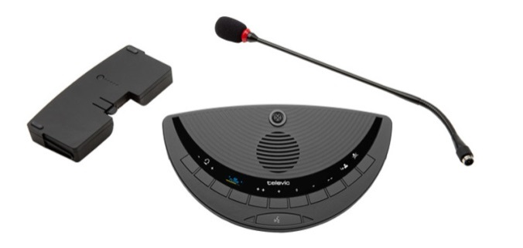
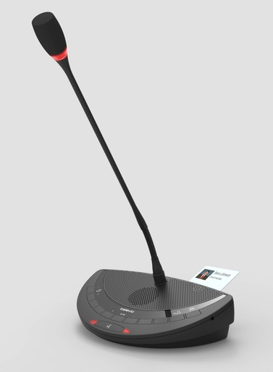
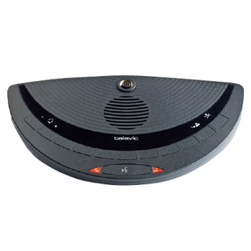
Generation 3 Televic Wireless Microphone Instructions
The Televic Wireless Microphone is an interactive device with three parts: battery, microphone and speaker.
If the microphone is initialized for speaking purposes, the discussion unit will automatically mute the speaker to avoid unit feedback
Once the microphone is turned off, the discussion unit speaker will be re-initialized and full volume will be restored
For best sound quality, speak approximately twelve inches into the microphone
To initiate the microphone press the middle button on the discussion unit
A red light on the discussion unit indicates the microphone is currently being used.
Please turn off the microphone after speaking to hear the audio at full volume

